Slide 1
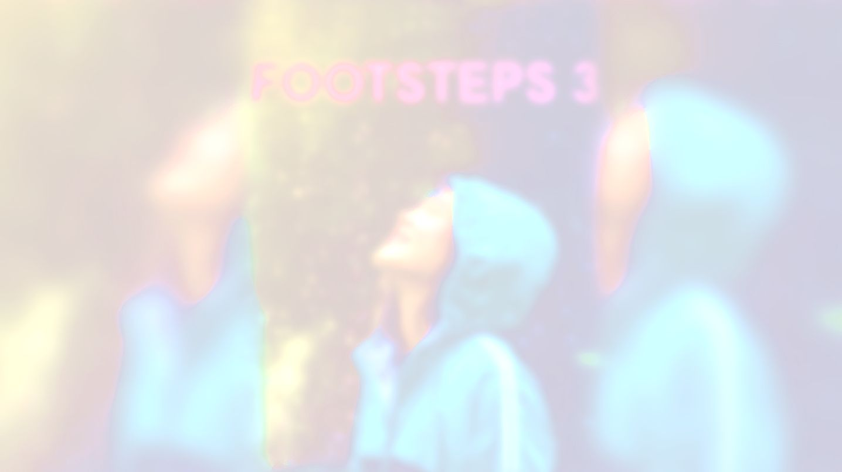


CULTURE SPOT 1;
Huge and different

Slide 2
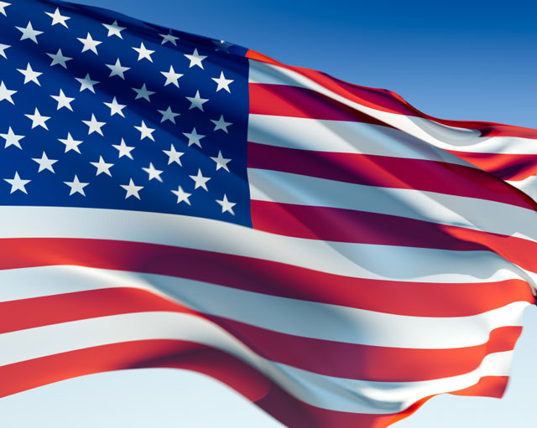
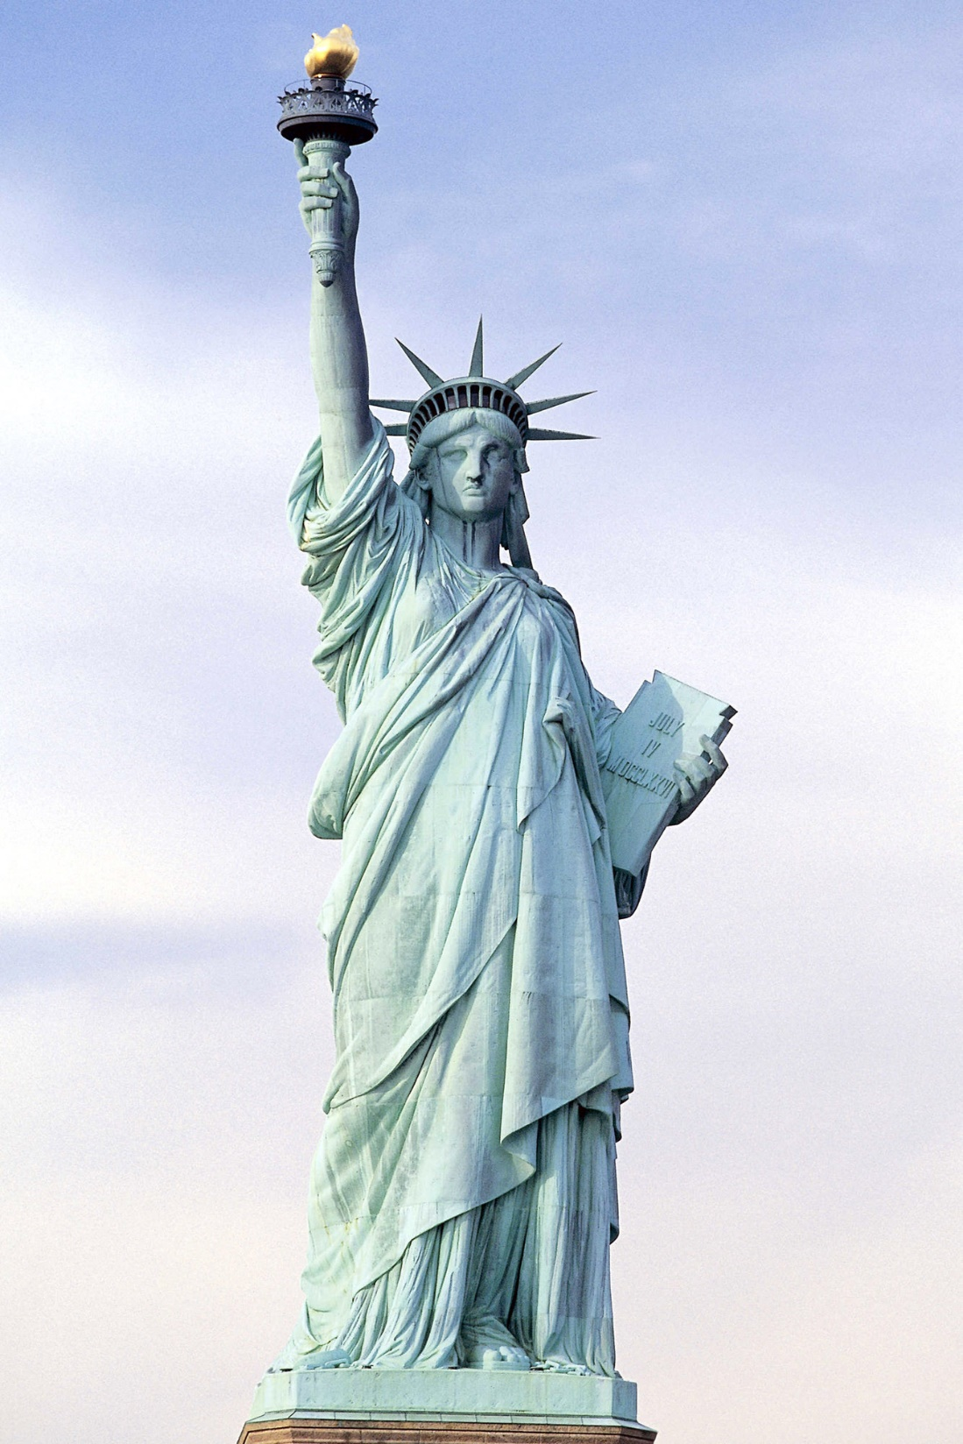
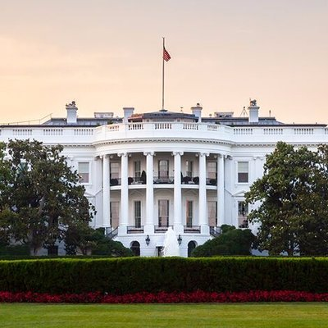
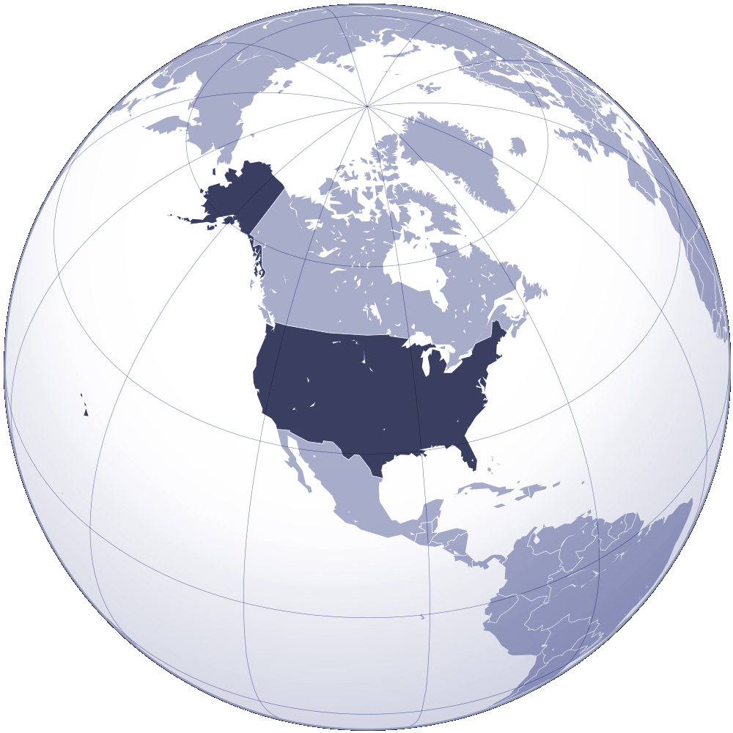
What can you see in these photos?

Slide 3





Write all the expressions you associate with the USA.
White House
New York
Statue of Liberty
the USA

Slide 4
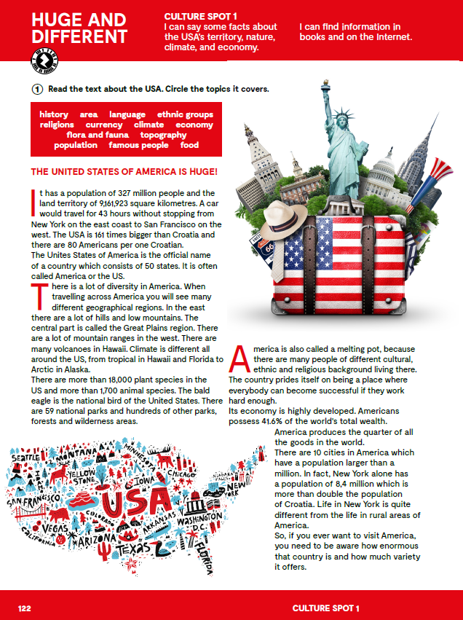
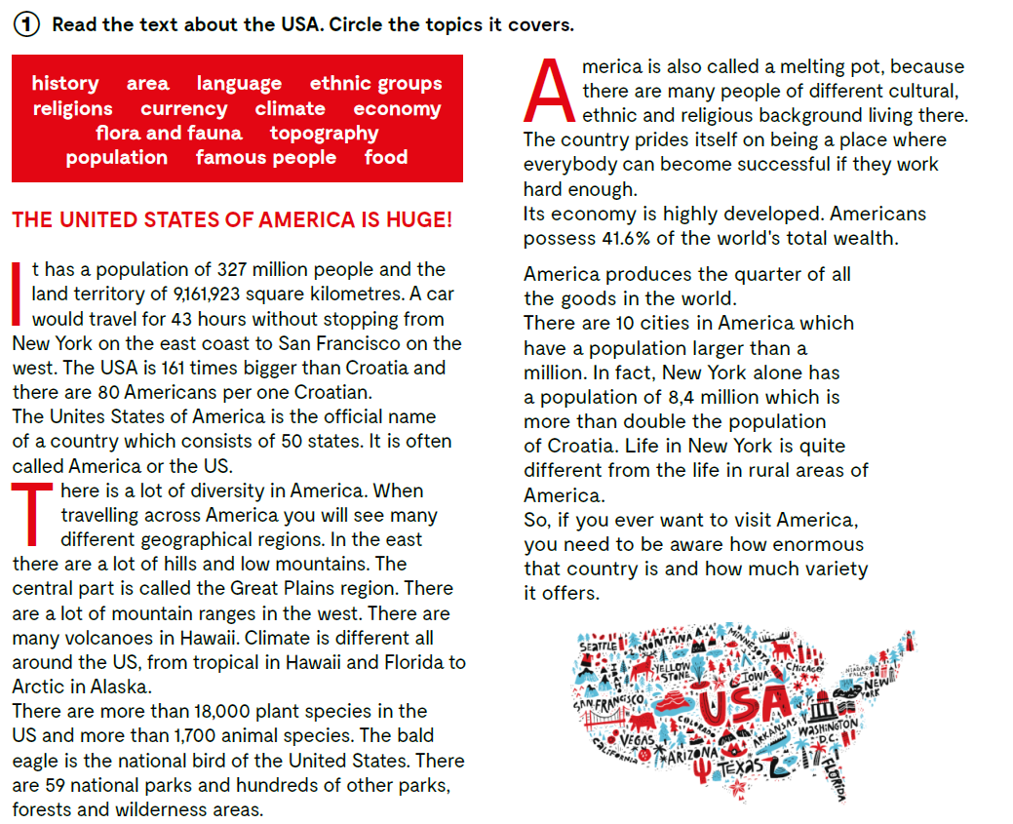


Slide 5
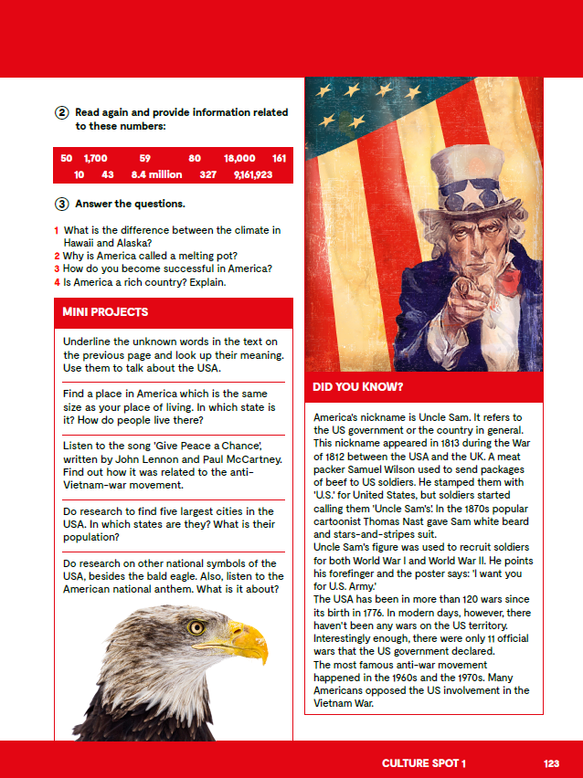
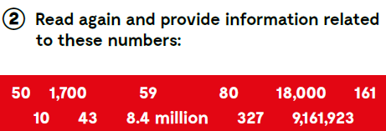
The Unites States of America consists of 50 states.
There are more than 1,700 animal in the US.
There are 59 national parks in the US.
There are 80 Americans per one Croatian.
There are more than 18,000 plant species in the US.
The USA is 161 times bigger than Croatia.
There are 10 cities in America which have a population larger than a million.
A car would travel for 43 hours without stopping from New York on the east coast to San Francisco on the west.
New York has a population of 8,4 million.
The USA has a population of 327 million people …
and the land territory of 9,161,923 square kilometres.

Slide 6
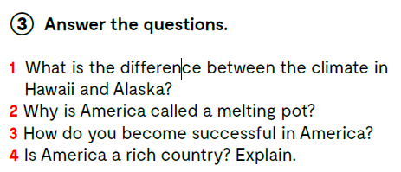
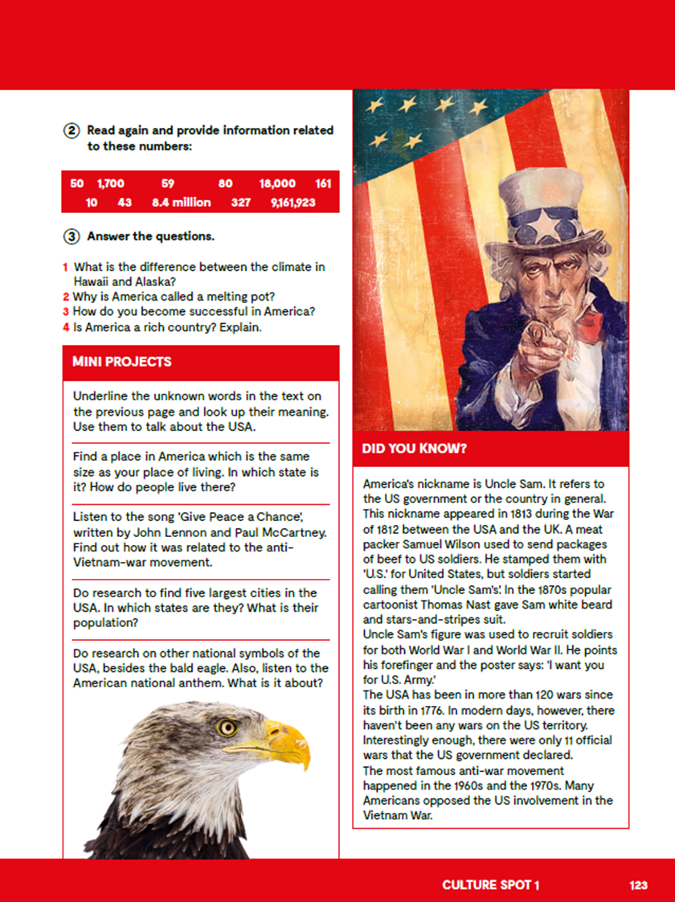
1 Climate is different all around the US, from tropical in Hawaii and Florida to Arctic in Alaska.
2 America is called a melting pot, because there are many people of different cultural, ethnic and religious background.
3 America is a place where everybody can become successful if they work hard enough.
4 America is a rich country. Its economy is highly developed. Americans possess 41.6% of the world’s total wealth and America produces the quarter of all the goods in the world.
Let’s practise: https://learningapps.org/watch?v=pdhcj1hn520

Slide 7

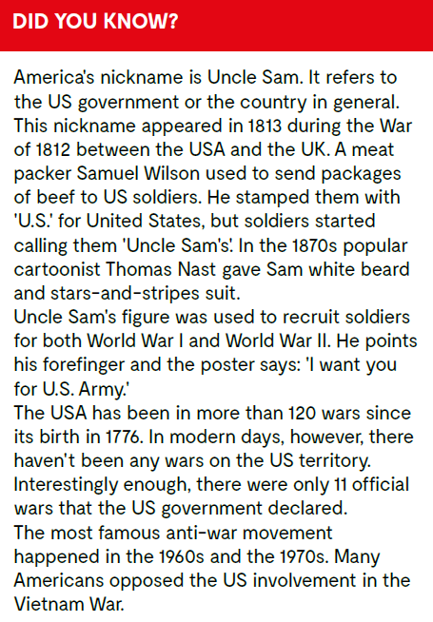
Translate:
stamped staviti žig
meat packer osoba koja pakira meso
cartoonist karikaturist
recruit novak
forefinger kažiprst
anti-war proturatni
involvement sudjelovanje

Slide 8
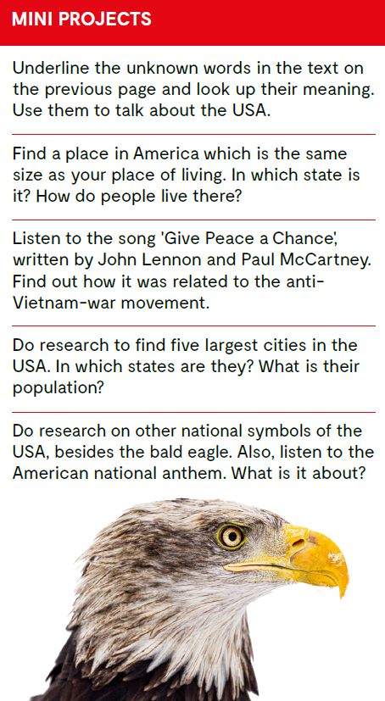
‘Give peace a chance’
himna.

